Slide 1
Week 6 Pointers part 1
CS 331
An introduction to C++ and Object-Oriented Programming
MD Romael Haque

Slide 2
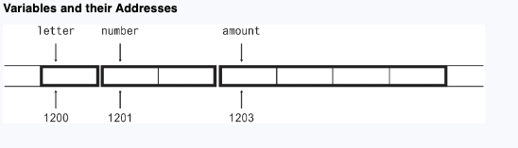
Pointers and the Address Operator
Every variable is assigned a memory location whose address can be retrieved using the address operator &.
The address of a memory location is called a pointer.
Each byte of memory has a unique address. A variable’s address is the address of the first byte allocated to that variable.

Slide 3
Pointers and the Address Operator
C++ has an address operator & that can be used to retrieve the address of any variable. - &amount
cout ≪ long(&amount);
By default, C++ prints addresses in hexadecimal.

Slide 4
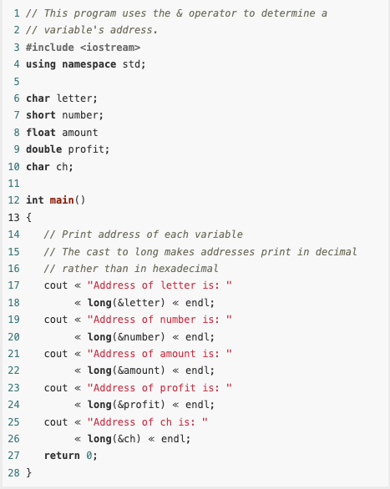
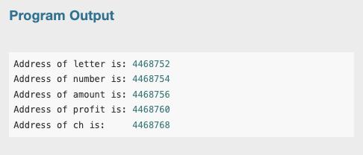
Example

Slide 5
Pointer Variables
Like other data values, memory addresses, or pointer values, can be stored in variables of the appropriate type.
A variable that stores an address is called a pointer variable, but is often simply referred to as just a pointer.
int *ptr;
The asterisk before the variable name indicates that ptr is a pointer variable, and the int data type indicates that ptr can only be used to point to, or hold addresses of, integer variables.

Slide 6
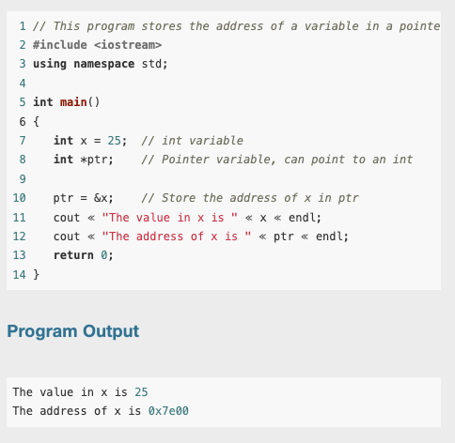
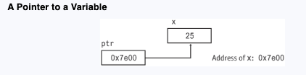
Example

Slide 7
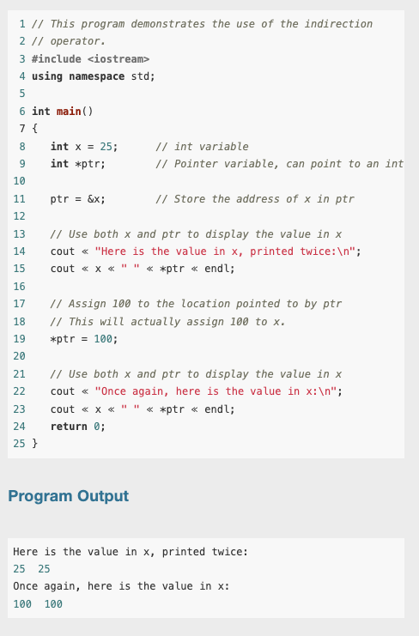
Example
You can use a pointer to indirectly access and modify the variable being pointed to.

Slide 8
The Relationship Between Arrays and Pointers
You learned earlier that an array name, without brackets and a subscript, actually represents the starting address of the array.
This means that an array name is really a pointer
So, Array names can be used as pointer constants, and pointers can be used as array names.

Slide 9
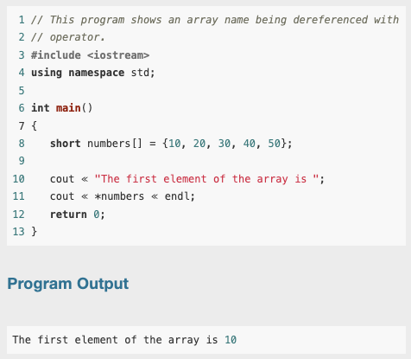
Example
Because numbers works like a pointer to the starting address of the array in.
In this program, the first element is retrieved when numbers is dereferenced.
So, how could the entire contents of an array be retrieved using the indirection operator?

Slide 10

The Relationship Between Arrays and Pointers
Remember, array elements are stored together in memory
It makes sense that if numbers is the address of numbers[0], values could be added to numbers to get the addresses of the other elements in the array.
It’s important to know, however, that pointers do not work like regular variables when used in mathematical statements.

Slide 11

The Relationship Between Arrays and Pointers
In C++, when you add a value to a pointer, you are actually adding that value times the size of the data type being referenced by the pointer.
In other words, if you add one to numbers, you are actually adding 1 * sizeof(short) to numbers. If you add two to numbers, the result is numbers + 2 * sizeof(short), and so forth.

Slide 12
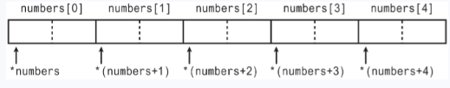
The Relationship Between Arrays and Pointers
This automatic conversion means that an element in an array can be retrieved by using its subscript or by adding its subscript to a pointer to the array.
If the expression *numbers, which is the same as *(numbers + 0), retrieves the first element in the array,
Then *(numbers + 1) retrieves the second element. Likewise, *(numbers + 2) retrieves the third element, and so forth.

Slide 13
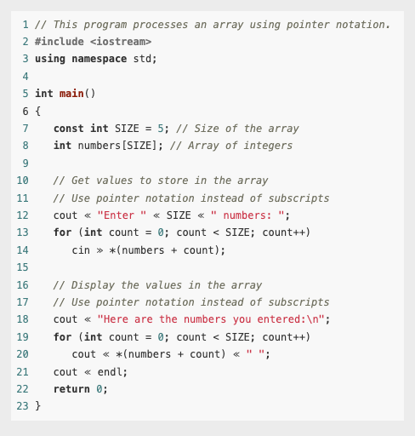
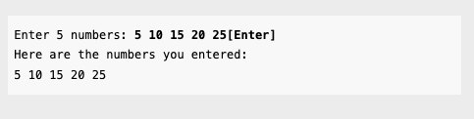
Example
array[index] is equivalent to *(array + index)

Slide 14
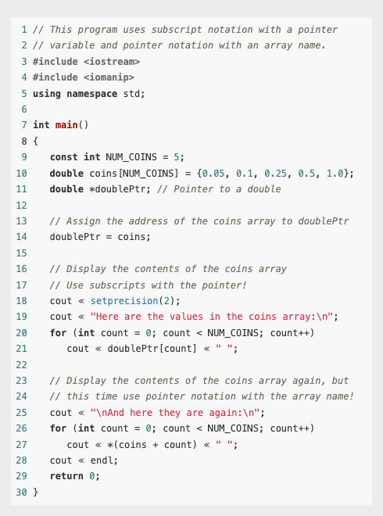
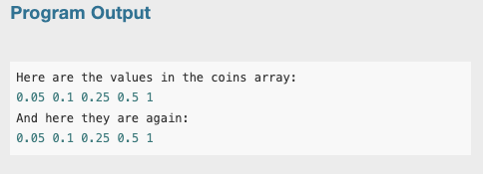
Example

Slide 15
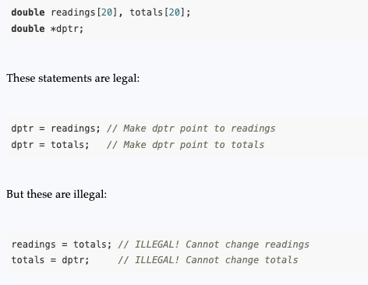
The Relationship Between Arrays and Pointers
The only difference between array names and pointer variables is that you cannot change the address an array name points to. For example, given the following definitions:
Array names are pointer constants. You can’t make them point to anything but the array they represent.

Slide 16
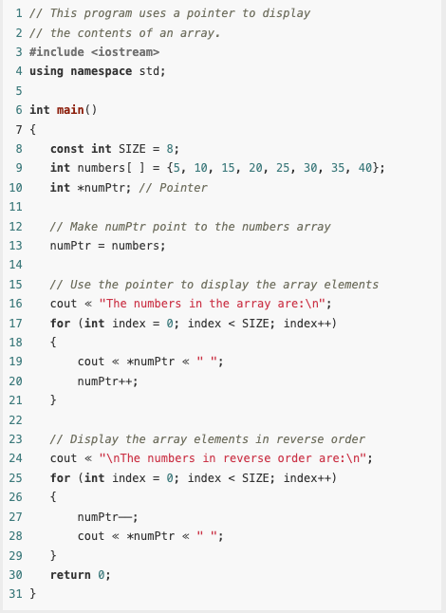
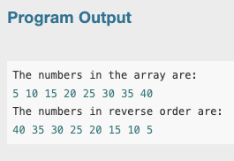
Pointer Arithmetic
The contents of pointer variables may be changed with mathematical statements that perform addition or subtraction
Because numPtr is a pointer, the increment operator adds the size of one integer to numPtr, so it points to the next element in the array. Likewise, the decrement operator subtracts the size of one integer from the pointer.

Slide 17
Pointer Arithmetic
Not all arithmetic operations may be performed on pointers.
For example, you cannot use multipication or division with pointers. The following operations are allowable:
The ++ and –– operators may be used to increment or decrement a pointer variable.
An integer may be added to or subtracted from a pointer variable. This may be performed with the + and – operators, or the += and −= operators.
A pointer may be subtracted from another pointer.

Slide 18



Initializing Pointers
Pointers may be initialized with the address of an existing object.
Remember that a pointer is designed to point to an object of a specific data type.
When a pointer is initialized with an address, it must be the address of an object the pointer can point to.
Legal
Legal
Illegal

Slide 19

Initializing Pointers
Pointers may be defined in the same statement as other variables of the same type.
int myValue, *pint = &myValue;
double readings[50], *marker = readings;
A pointer can only be initialized with the address of an object that has already been defined. The following is illegal

Slide 20

Initializing Pointers
A local pointer variable that has not been initialized does not hold a valid address, and an attempt to use such a pointer will result in execution-time errors.
The convention in older versions of C++ is to assign the address 0 to a pointer that does not currently point to a valid memory location:
In many computers, the address 0 is occupied by operating system data and is not accessible to user programs. This makes 0 a safe choice for a value that indicates an invalid memory location.

Slide 21


Initializing Pointers
Many header files, including iostream, fstream, and cstdlib, define a constant named NULL to represent the pointer value 0
A pointer whose value is 0 is called a null pointer. C++ 11 defines the key word nullptr to indicate an invalid memory address:

Slide 22

Initializing Pointers
You can test a pointer p against 0, NULL, or nullptr to determine if it points to a valid address using equality-testing operators != and ==. For example,

Slide 23
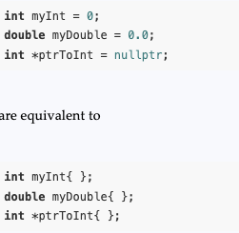
Initializing Pointers
In C++ 11, putting an empty pair of braces { } at the end of a variable definition initializes the variable to its default value. The default value for numeric types such as int, long, and double is zero, while the default value for pointer types is nullptr.

Slide 24
Comparing Pointers
C++’s relational operators may be used to compare pointer values. > < == != >= <=
If one address comes before another address in memory, the first address is considered “less than” the second.
In an array, all the elements are stored in consecutive memory locations, so the address of element 1 is greater than the address of element 0.

Slide 25
Comparing pointers
Because the addresses grow larger for each subsequent element in the array, the following Boolean expressions are all true:
&array[1] > &array[0]
array < &array[4]
array == &array[0]
&array[2] != &array[3]

Slide 26
Comparing pointers
Comparing two pointers is not the same as comparing the values the two pointers point to. For example, the following if statement compares the addresses stored in the pointer variables ptr1 and ptr2:
if (ptr1 < ptr2)
The following statement, however, compares the values that ptr1 and ptr2 point to:
if (*ptr1 < *ptr2)
The capability of comparing addresses gives you another way to be sure a pointer does not go beyond the boundaries of an array.

Slide 27
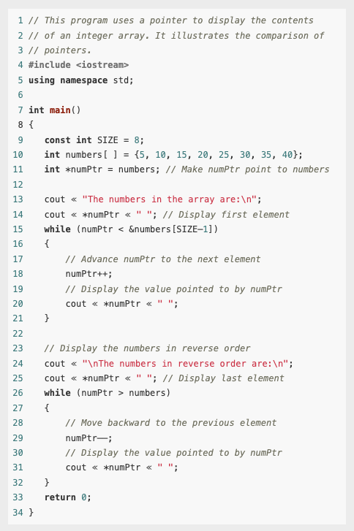
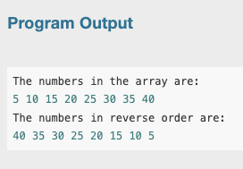
Example

Slide 28
Comparing pointers
Most comparisons involving pointers compare a pointer to 0, NULL, or nullptr to determine whether the pointer points to a legitimate address. For example, assuming that ptrToInt has been defined as a pointer to int, the code prints the integer pointed to only after verifying that ptrToInt is not a null pointer.
if (ptrToInt != nullptr)
cout ≪ *ptrToInt;
else
cout ≪ "null pointer";

Slide 29
Pointers as Function Parameters
A pointer can be used as a function parameter. It gives the function access to the original argument, much like a reference parameter does.
A reference variable acts as an alias to the original variable used as an argument.
This gives the function access to the original argument variable, allowing it to change the variable’s contents.
When a variable is passed into a reference parameter, the argument is said to be passed by reference.
An alternative to passing an argument by reference is to use a pointer variable as the parameter.

Slide 30
Pointers as Function Parameters
Admittedly, reference variables are much easier to work with than pointers. Reference variables hide all the “mechanics” of dereferencing and indirection.
You should still learn to use pointers as function arguments, however, because some tasks requires it.
Also, the C++ library has many functions that use pointers as parameters.

Slide 31

Pointers as Function Parameters
This statement multiplies the original variable, whose address is stored in val, by two.
When the function is called, the address of the variable that is to be doubled must be used as the argument, not the variable itself. such as doubleValue(&number);

Slide 32
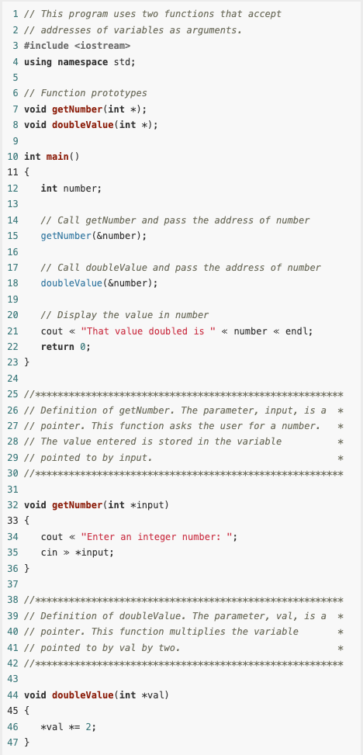
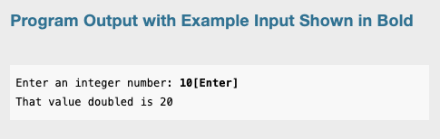
Example
It’s critical that the indirection operator be used in the (cin >> *input) statement.
Without it, cin would store the value entered by the user in input, as if the value were an address.
If this happens, input will no longer point to the number variable in function main. Subsequent use of the pointer will result in erroneous, if not disastrous, results.

Slide 33
Pointers to Constants and Constant Pointers
A pointer to a constant may not be used to change the value it points to;
A constant pointer may not be changed after it has been initialized.

Slide 34
Pointers to Constants
You have seen how an item’s address can be passed into a pointer parameter, and the pointer can be used to modify the item that was passed as an argument.
Sometimes it is necessary to pass the address of a const item into a pointer. When this is the case, the pointer must be defined as a pointer to a const item.

Slide 35

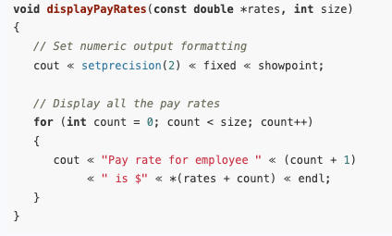
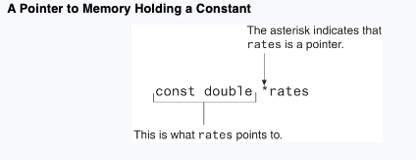
Example
In this code, payRates is an array of const doubles.
This means that each element in the array is a const double, and the compiler will not allow us to write code that changes the array’s contents.
If we want to pass the payRates array into a pointer parameter, the parameter must be declared as a pointer to const double.
In the function header, notice that the rates parameter is defined as a pointer to const double. It should be noted that the word const is applied to the thing that rates points to, not rates itself.
Because rates is a pointer to a const, the compiler will not allow us to write code that changes the thing that rates points to.
Because rates is a pointer to a const, the compiler will not allow us to write code that changes the thing that rates points to.

Slide 36
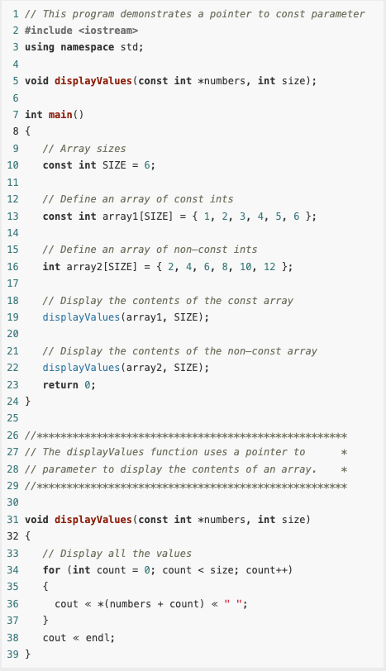
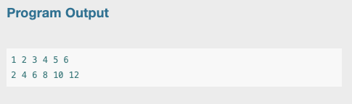
Passing a Non-Constant Argument into a Pointer to a Constant
Although a constant’s address can be passed only to a pointer to const, a pointer to const can also receive the address of a non-constant item.
When writing a function that uses a pointer parameter, and the function is not intended to change the data the parameter points to, it is always a good idea to make the parameter a pointer to const.
Not only will this protect you from writing code in the function that accidentally changes the argument, but the function will be able to accept the addresses of both constant and non-constant arguments.

Slide 37
Constant Pointers
We discussed pointers to const, that is, pointers that point to const data. You can also use the const key word to define a constant pointer. Here is the difference between a pointer to const and a const pointer:
A pointer to const points to a constant item. The data that the pointer points to cannot change, but the pointer itself can change.
With a const pointer, it is the pointer itself that is constant. Once the pointer is initialized with an address, it cannot point to anything else.

Slide 38
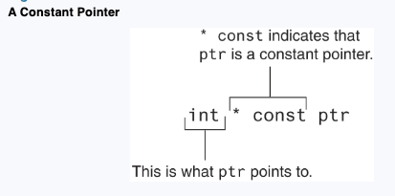

Constant Pointers
In the code, ptr is initialized with the address of the value variable. Because ptr is a constant pointer, a compiler error will result if we write code that makes ptr point to anything else. An error will not result, however, if we use ptr to change the contents of value. This is because value is not constant, and ptr is not a pointer to const.

Slide 39
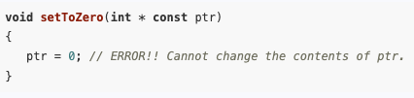
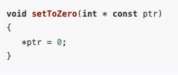
Constant Pointers
Constant pointers must be initialized with a starting value, as shown in the previous example code.
If a constant pointer is used as a function parameter, the parameter will be initialized with the address that is passed as an argument into it and cannot be changed to point to anything else while the function is executing.
However, ptr does not point to a const, so we can have code that changes the data that ptr points to.

Slide 40
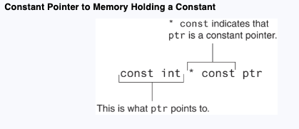

Constant Pointers to Constants
So far, when using const with pointers we’ve seen pointers to constants and we’ve seen constant pointers.
We can also have constant pointers to constants.
In the code, ptr is initialized with the address of value. Because ptr is a const pointer, we cannot write code that makes ptr point to anything else. Because ptr is a pointer to const, we cannot use it to change the contents of value.

Slide 41
Dynamic Memory Allocation
Variables may be created and destroyed while a program is running.
if you don’t know how many variables to define - we allow the program to create its own variables “on the fly.”
This is called dynamic memory allocation and is only possible through the use of pointers.

Slide 42
Dynamic Memory Allocation
To dynamically allocate memory means that a program, while running, asks the computer to set aside a chunk of unused memory large enough to hold a variable of a specific data type.
Let’s say a program needs to create an integer variable. It will make a request to the computer that it allocate enough bytes to store an int.
When the computer fills this request, it finds and sets aside a chunk of unused memory large enough for the variable.
It then gives the program the starting address of the chunk of memory. The program can only access the newly allocated memory through its address, so a pointer is required to use those bytes.

Slide 43
Dynamic Memory Allocation
The way a C++ program requests dynamically allocated memory is through the new operator. Assume a program has a pointer to an int defined as
int *iptr = nullptr;
You can use the new operator to dynamically allocate an integer variable and assign the address of the newly allocated variable to iptr like this:
iptr = new int;

Slide 44
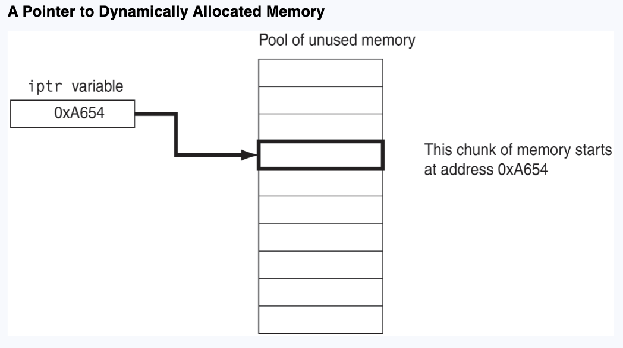
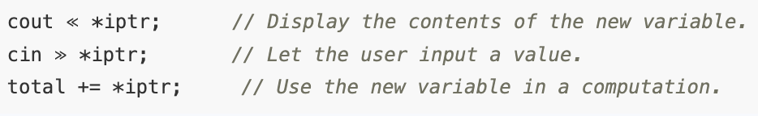
Dynamic Memory Allocation

Slide 45
Stack and Heap
In C++, memory is divided into different regions, primarily the stack and heap. Each serves a distinct purpose and has different characteristics regarding memory allocation, management, and lifetime.
The stack is a region of memory that stores temporary variables created by each function (local variables).
The heap is a region of memory used for dynamic memory allocation.
Unlike the stack, memory on the heap can be allocated and deallocated at any time during the program's execution.

Slide 46
Stack and Heap
Memory allocation on the stack is done automatically when a function is called and deallocated when the function exits.
Local variables, function parameters, and return addresses are stored on the stack.
Variables stored in stack memory are only available within the scope of the function in which they are declared. Once the function exits, the memory is reclaimed automatically.

Slide 47
Stack and Heap
Memory on the heap is allocated using the new operator and deallocated using the delete operator.
This allows for creating data structures with variable sizes that can grow or shrink as needed.
The heap has a larger size limit than the stack and is typically only constrained by the amount of available memory on the system.
Variables stored in heap memory persist until they are explicitly deallocated using delete. They remain accessible across function calls as long as the pointer to them remains valid.

Slide 48
When to use?
Short-Lived vs long-lived variable
Known Size at Compile Time vs Dynamic Size whose size may change during runtime or is not known at compile time.
Stack use cases - Local variables, function parameters;
Heap use cases - Arrays with unknown size at compile time, objects

Slide 49


Dynamic Memory Allocation
Every call to new allocates storage from the heap.
A program that has finished using a dynamically allocated block of memory should free the memory and return it to the heap to make it available for future use.
This is accomplished by calling the delete operator and passing it the address of the memory to be deallocated.
After delete has completed, the value of the pointer should be set to nullptr to indicate that it is no longer valid.

Slide 50
Dangling Pointers
A pointer is said to be dangling if it is pointing to a memory location that has been freed by a call to delete.
When you access a dangling pointer, you are trying to use memory that has already been freed and returned to the heap.
In fact, such memory may already be reallocated by another call to new.
You can avoid the use of dangling pointers by always
setting pointers to null as soon as their memory is freed, and
verifying that a pointer is not null before you attempt to access its memory.

Slide 51
Dangling Pointers and Memory Leaks
A memory leak is said to occur in your program if, after you have finished using a block of memory allocated by new, you forget to free it via delete.
The leaked block of memory remains unavailable for use until the program terminates.
Memory leaks are especially serious when they occur in loops.
They are even more serious in programs such as Web servers and other network programs that are expected to run for months or even years without being shut down. Over time, a Web server with a memory leak will exhaust all memory in the computer on which it is running, requiring both it and the computer to be shut down and restarted.

Slide 52
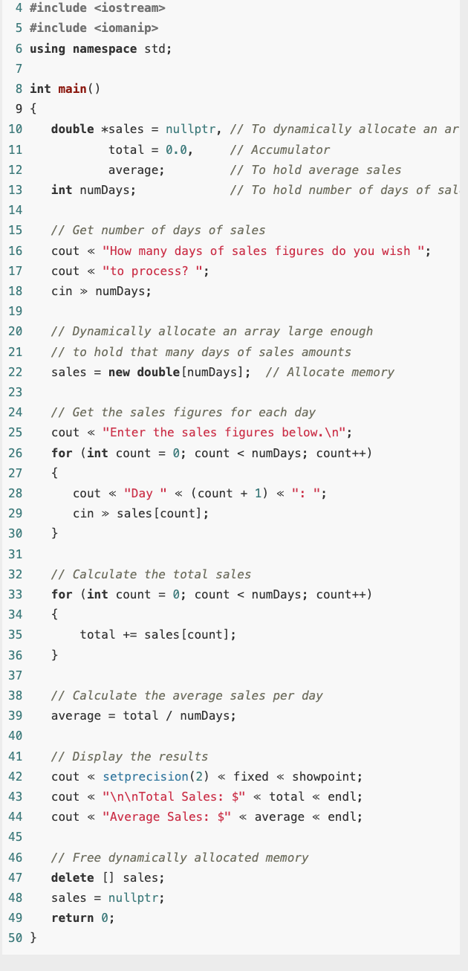
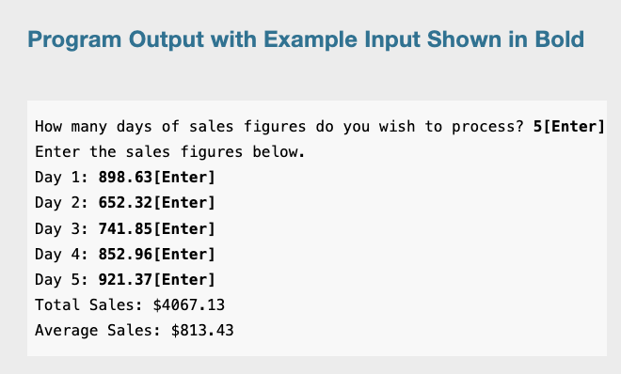
Example

Slide 53
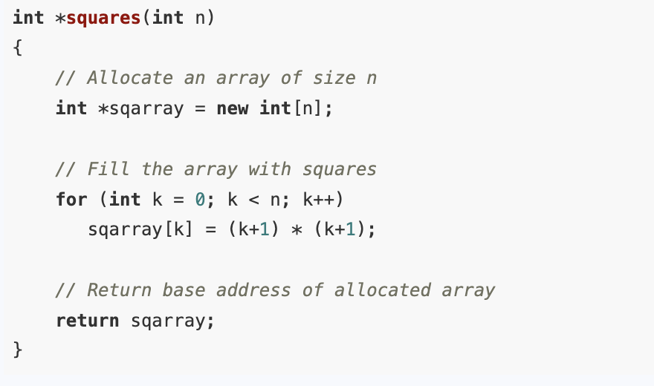
Returning Pointers from Functions
Functions can return pointers, but you must be sure the item the pointer references still exists.
It is often useful for a function to dynamically allocate storage for an object, fill the object with data, and return its address.
Consider a function that returns for a given positive integer the sequence of the first integer squares. For example, if the function is passed the value 4, it returns an array whose elements are 1, 4, 9, and 16.
When called, the function allocates an array of the given size, sets the elements of the array to the required values, and returns the address of the base of the array.

Slide 54
Stopping memory leaks
It is important for programs that use dynamically allocated memory to ensure that each call to new is eventually followed by a call to delete that frees the allocated memory and returns it to the heap.
Whenever possible, the function that invokes new to allocate storage should also be the function that invokes delete to deallocate the storage.

Slide 55
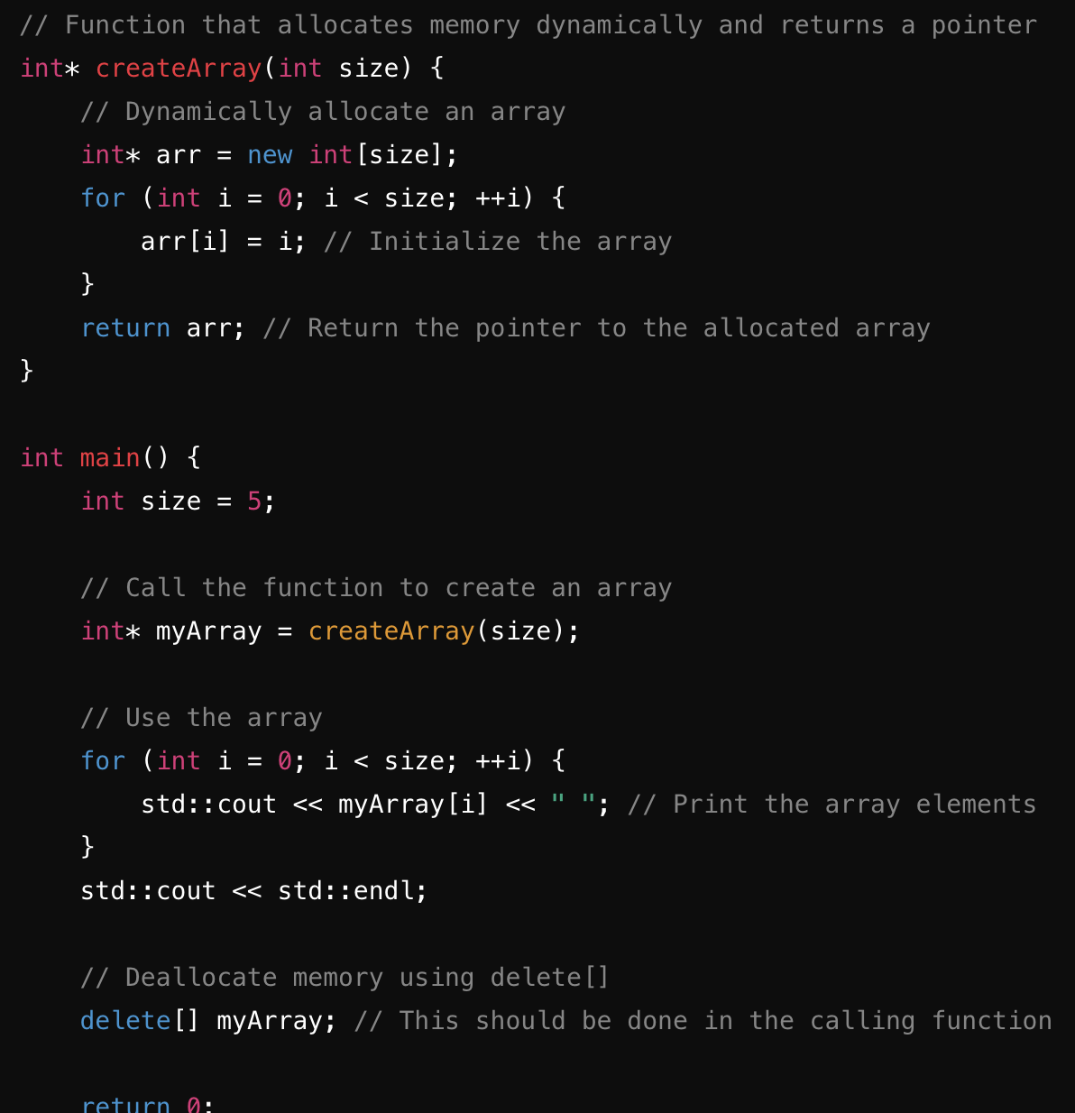
Example

Slide 56
Smart Pointers
C++ 11 introduces smart pointers, objects that work like pointers but have the ability to automatically delete dynamically allocated memory that is no longer being used.
Can avoid dangling pointers, double deletion
C++ 11 provides three types of smart pointers defined by classes called unique_ptr, shared_ptr, and weak_ptr. We will refer to these as unique pointers, shared pointers, and weak pointers.
A smart pointer is said to own or manage the object that it points to.

Slide 57
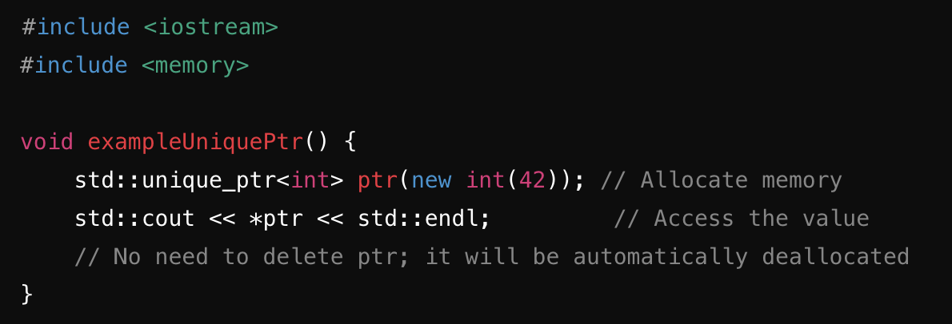
Smart Unique Pointers
std::unique_ptr
Ownership: Represents exclusive ownership of a dynamically allocated object. Only one unique_ptr can own a specific resource at a time.
Transfer Ownership: Ownership can be transferred using std::move().
Automatic Deallocation: Automatically deallocates memory when it goes out of scope.
Use Case: When you want a single owner of a resource.

Slide 58
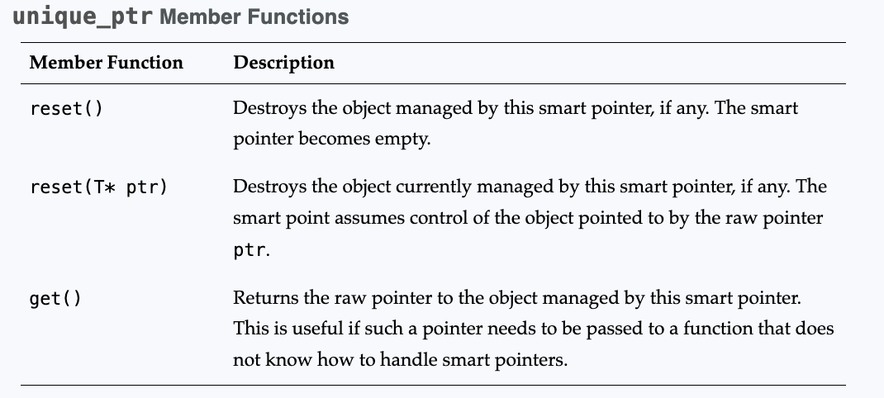
Smart Unique Pointers

Slide 59
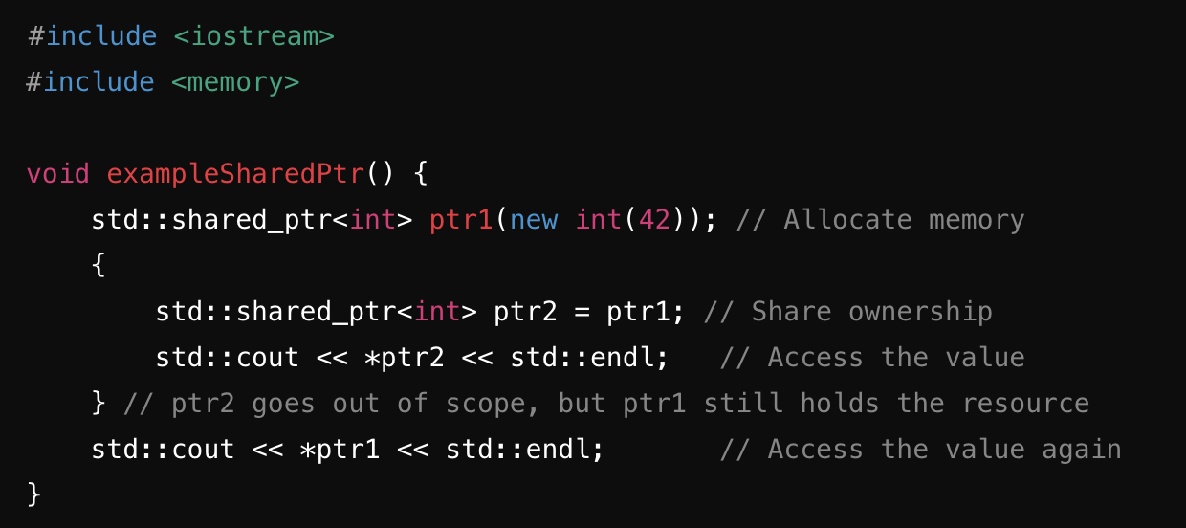
Smart Shared Pointers
std::shared_ptr
Ownership: Allows multiple smart pointers to share ownership of a single resource. The resource is deallocated when the last shared_ptr pointing to it is destroyed or reset.
Reference Counting: Maintains a reference count to track how many shared_ptr instances point to the same resource.
Use Case: When multiple owners of a resource are needed.

Slide 60
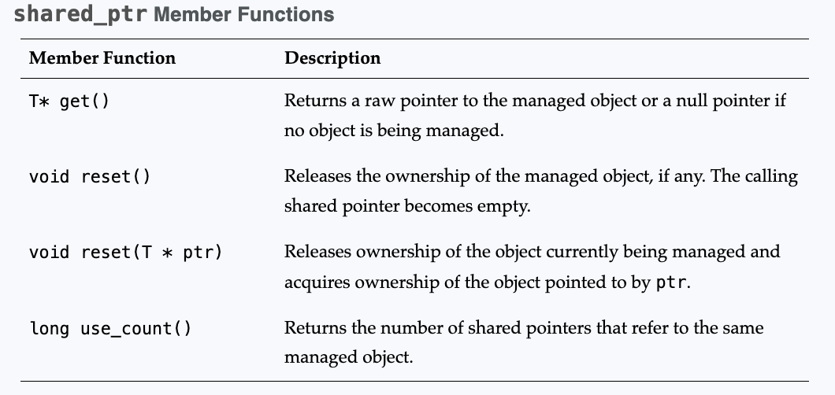
Smart Shared Pointers

